Slide 1
Retail Digital Supply Chain
Where to Start with Analytics
Santiago Gallino, Charles W. Evans Distinguished Faculty Scholar and Assistant Professor of Operations, Information and Decisions

Slide 2
Supply Chain Analytics
Where to start with analytics?
Can sound trivial, but is an important step for a successful process

Slide 3
Unpromising Approaches
“We are here to help. Do you have a problem to solve?”
Lack of motivation
Boil the ocean
Lack of focus
“3 years and 10 million dollars from now… it is going to be great.”
Lack of business value

Slide 4
Promising Approach
Start with high level business problems
Tightly defined
Promptly addressable
Evident business value
Show business results

Slide 5
What Analytics is Right for You?
Individual impact of the
analytic project, scalability
Business Impact
Complexity
Data requirements, analytic skills,
implementation difficulty

Slide 6
What Analytics is Right for You?
No Brainers
Business Impact
Unattractive
Complexity

Slide 7
Retail Digital Supply Chain
Analytics Framework
Santiago Gallino, Charles W. Evans Distinguished Faculty Scholar and Assistant Professor of Operations, Information and Decisions

Slide 8
Descriptive Analytics
What happened?
Use historical data to make better decisions going forward
Visual reports
Alerts
Data mapping
Business Impact
Complexity

Slide 9
Diagnostic Analytics
Why did it happen?
Database queries
Data mining
Statistical analysis
Business Impact
Complexity

Slide 10
Predictive Analytics
What will happen?
Forecasting
Simulation
Business Impact
Complexity

Slide 11
Prescriptive Analytics
How do I make it happen?
Optimization
Machine learning
Artificial intelligence
Business Impact
Complexity

Slide 12
Analytics Framework
Descriptive analytics
Diagnostic analytics
Predictive analytics
Prescriptive analytics
Business Impact
Complexity

Slide 13
Retail Digital Supply Chain
Descriptive Analytics
Santiago Gallino, Charles W. Evans Distinguished Faculty Scholar and Assistant Professor of Operations, Information and Decisions

Slide 14
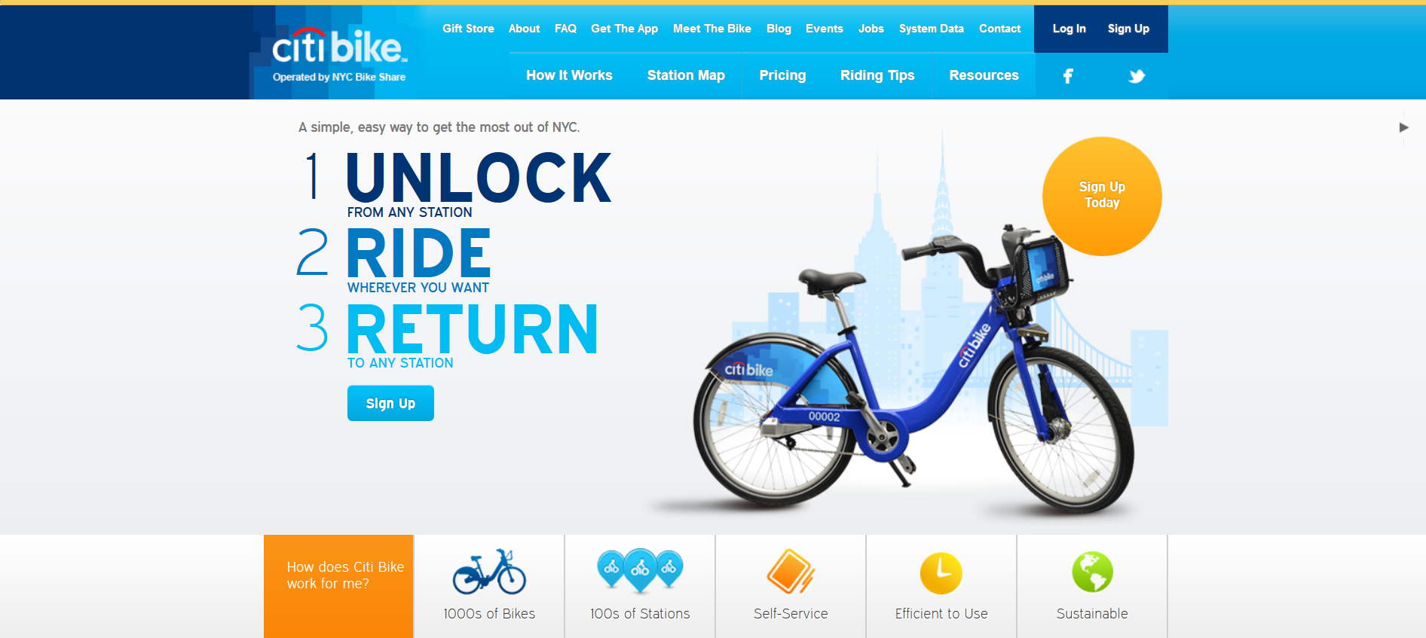
Descriptive Analytics: Citibike

Slide 15
Descriptive Analytics: Citibike
Program allows customers to borrow a bike
Main challenge is the location of bikes in the system
Bikes tend to get stuck in one set of stations
Relocation of bikes can be critical to maximize the usage of the bikes
One first step in understanding the problem is to visualize the data

Slide 16
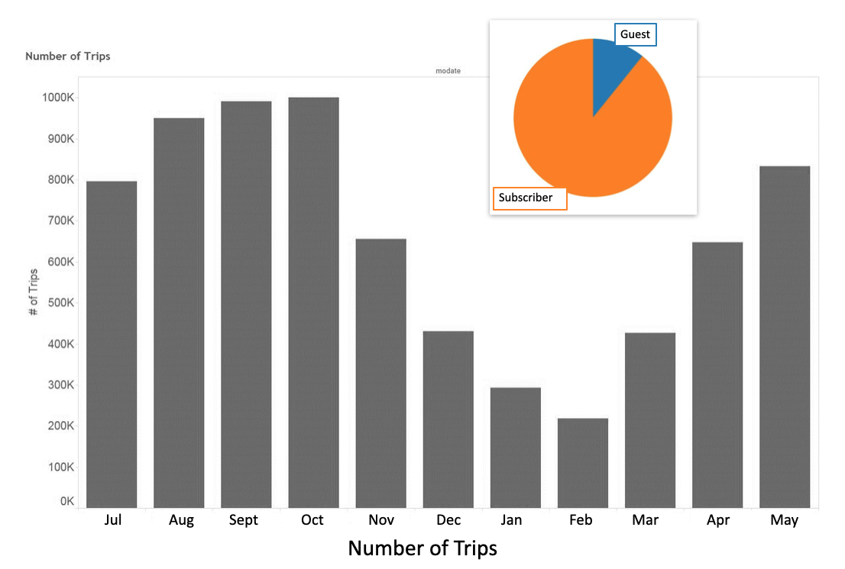
What is the Average Number of Trips?

Slide 17
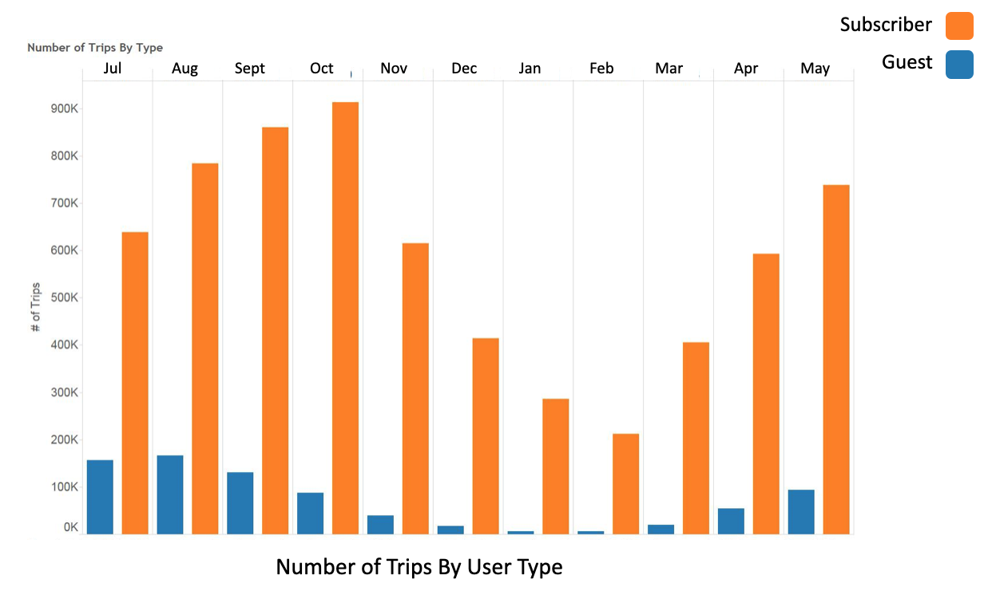
What is the Average Number of Trips?

Slide 18
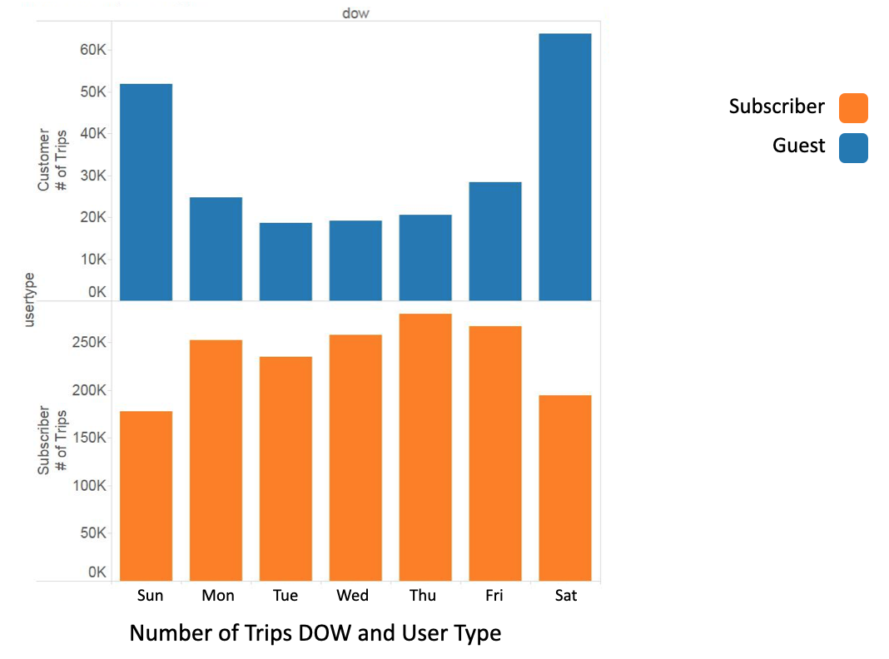
What is the Average Number of Trips?

Slide 19
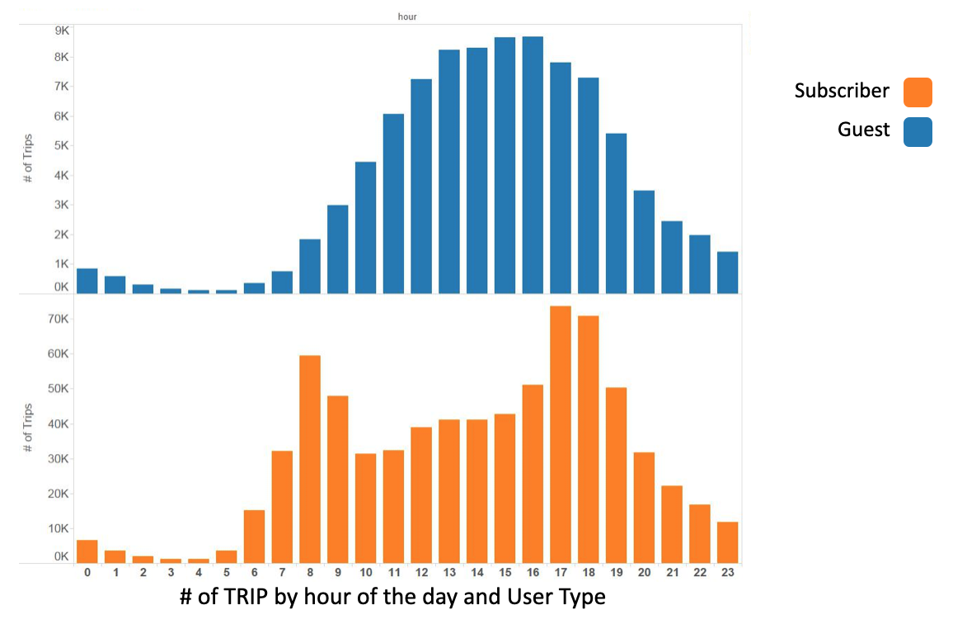
What is the Average Number of Trips?

Slide 20
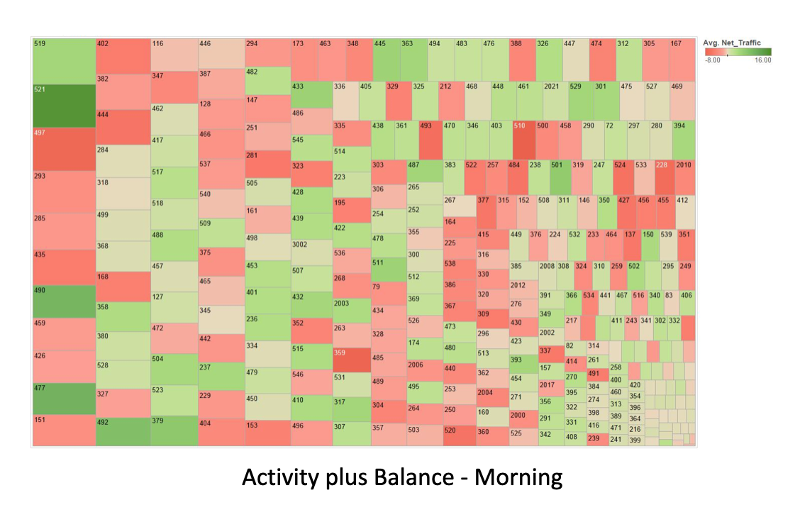
Which Ones are the Busy Stations?

Slide 21
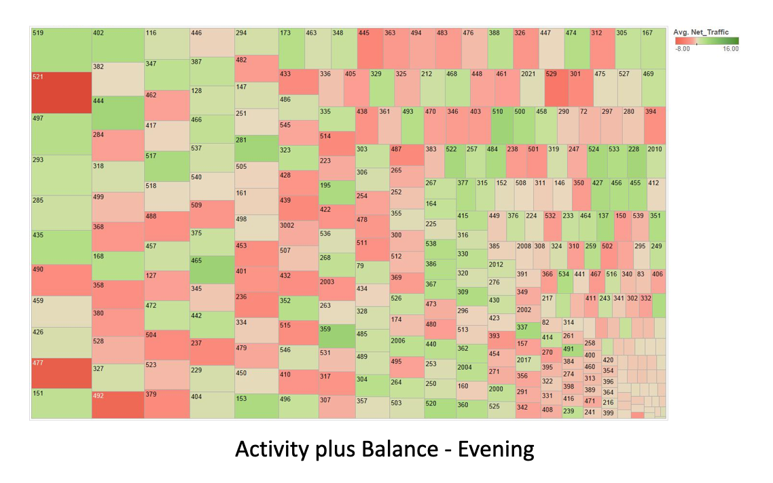
Which Ones are the Busy Stations?

Slide 22
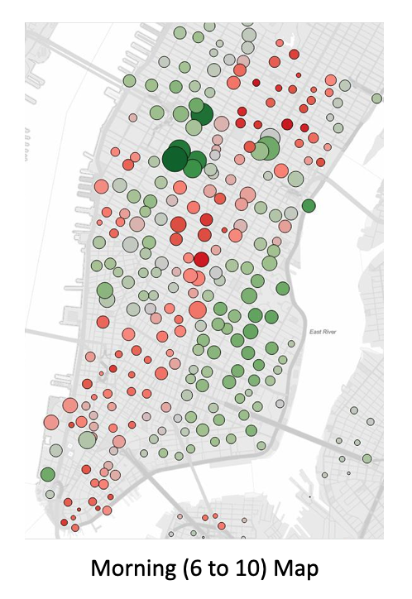
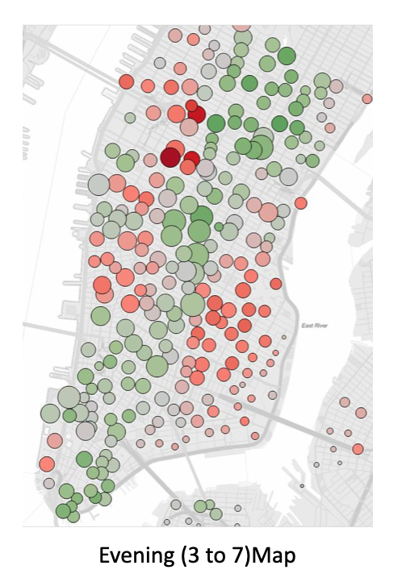
Which Ones are the Busy Stations?

Slide 23
Valuable Insights from the Data Visualization
Two different types of customers
Subscribers and guests
Role of the different stations

Slide 24
Parallels in Retail Store Locations
Stores that have more business customers, or more occasional customers, or more family-oriented customers
Patterns of when, how, and what they buy
Map of store locations tracking flow of demand during different times of the day
Difference in categories within a specific store
Dollar sales
Profit
Profit per SKU

Slide 25
Data Visualization
Best when done dynamically
Monitoring constantly will allow you to detect when there is a variation from what has historically been happening
Can be extremely effective to identify problems and opportunities

Slide 26
Retail Digital Supply Chain
Diagnostic Analytics
Santiago Gallino, Charles W. Evans Distinguished Faculty Scholar and Assistant Professor of Operations, Information and Decisions

Slide 27
Research Question
Retailer discussing where to locate a new distribution center
Some people arguing that the location should be driven by cost alone
Some arguing to consider impact of delivery speed to the customer
Customers that receive things sooner tend to buy more
How can we look at historical data to answer the question of where to best locate the distribution center?
Should we care about the impact on delivery speed at all, or should we only focus on cost?

Slide 28
Research Question
Natural experiment
The researcher (the person doing the analytics) is not in control of the allocation of the treatment
In order to analyze things in a natural experiment, we need to identify a control group and a treatment group

Slide 29
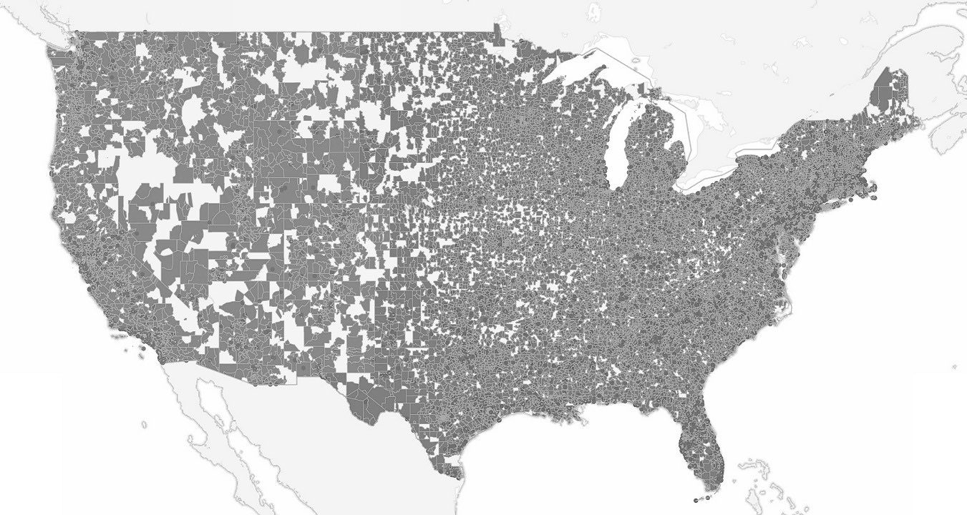
Prior to Intervention
Customers on the east coast were receiving the products in 2-3 days
West coast customers were receiving the products within 7-8 days
On the website, the retailer was promising standard shipping times of 3-7 business days

Slide 30
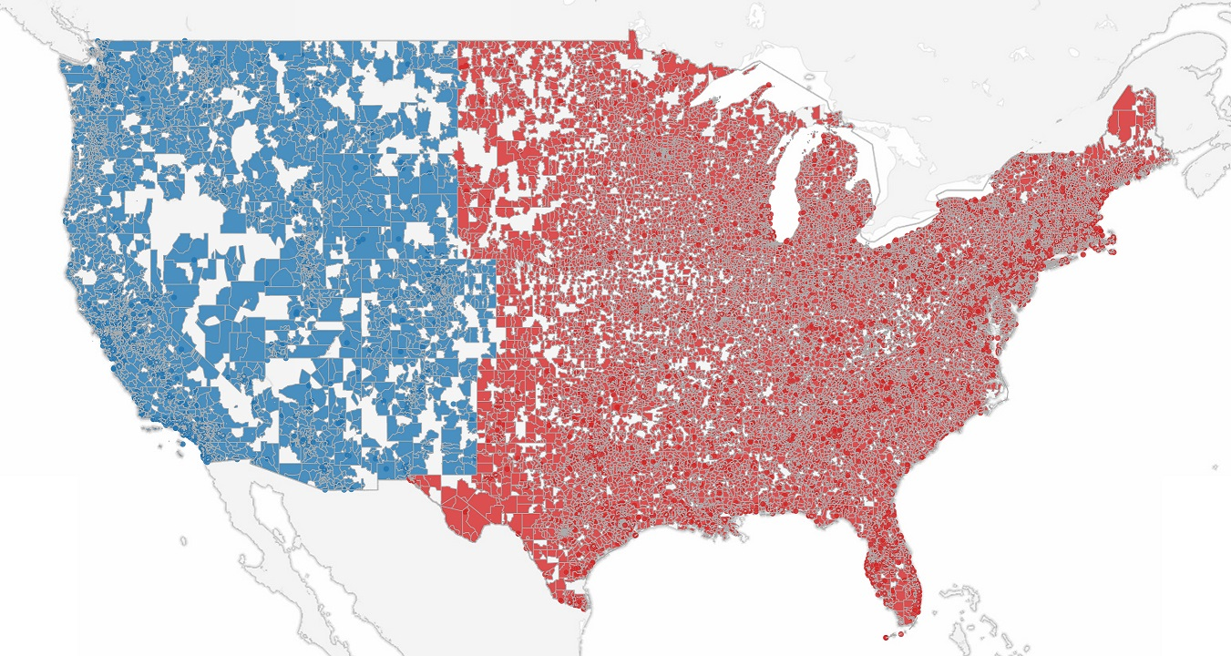
After Intervention
Anyone from the center of the country to the west would be fulfilled exclusively by the west distribution center
Anyone from the center of the country to the east would be exclusively fulfilled by the east distribution center

Slide 31
After Intervention
This created a natural experiment
The customers on the east were receiving things just like before, with the same timing
The customers on the west were seeing a much improved speed, from 7-8 business days to 2-3 business days

Slide 32
After Intervention
Are the customers in the west who are now receiving the products sooner placing more orders?
Key point — the shipping promise on the website was still the same

Slide 33
After Intervention
What is the impact of reducing the delivery time to the customer?
Online customers from the west coast placed 1.4% more orders after the opening of the second distribution center
Supported the argument that delivery speed would help sales
Supported the idea that when opening the third distribution center, they should consider not only the cost, but the impact to potential sales

Slide 34
Diagnostic Questions
Diagnostic problems are relevant and prevalent in the retail space
Many retailers that started their business exclusively as online retailers have moved into the physical space
To what extent is the physical presence of a retail store that has no inventory (a showroom) beneficial to the customer?
This question will inform future investments in other physical presence

Slide 35
Diagnostic Questions Example: Apparel Retailer
Goal: To understand the impact of a zero inventory store (ZIS) on existing customers or new customer
What is the impact of the showroom on the future behavior of the customers?
Does the visit to the showroom increase the value of the customer over time?
Does the visit to the showroom make the interaction of the customer with the company more cost effective?
In what situations is the visit to the showroom more impactful?

Slide 36
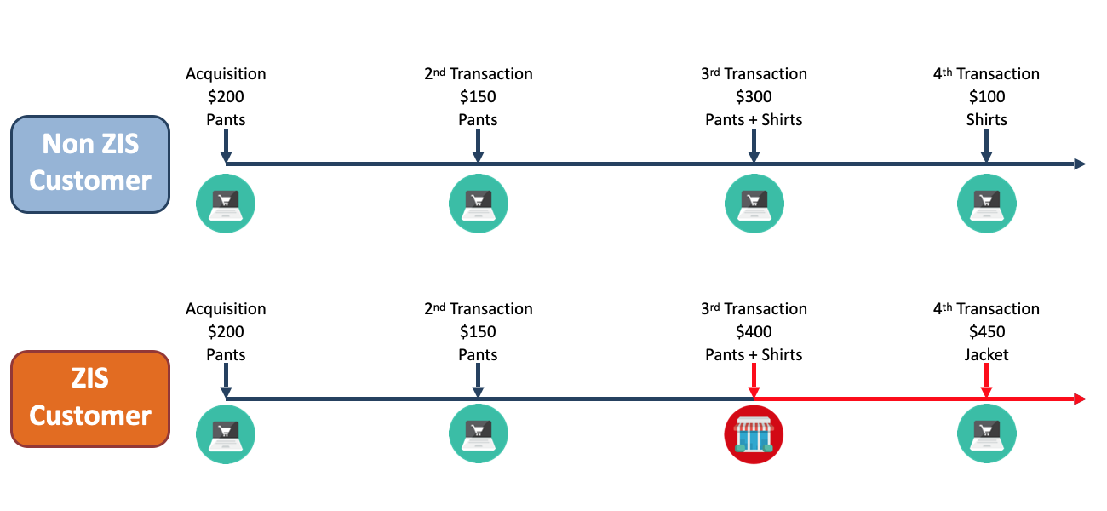
How are Customers Impacted When They Visit a ZIS?

Slide 37
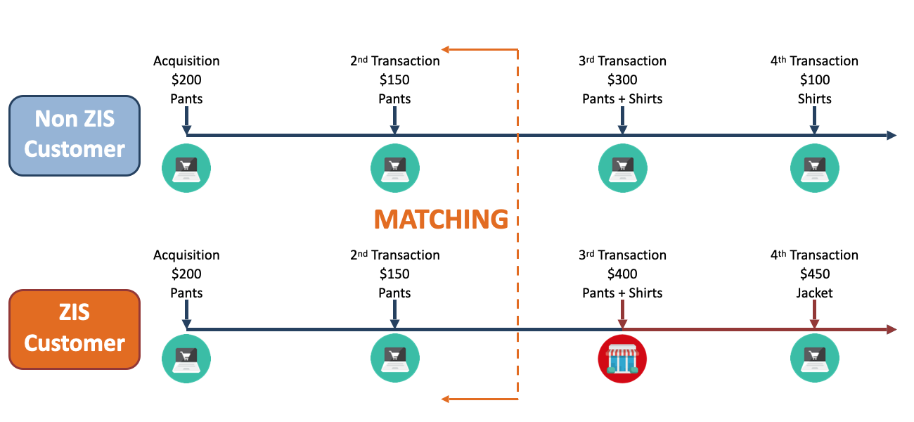
How are Customers Impacted When They Visit a ZIS?

Slide 38
Impact of ZIS
A visit to the showroom will drive:
Incremental dollar sales
More order frequency
Average item price
Fewer product returns

Slide 39
Retail Digital Supply Chain
Predictive Analytics
Santiago Gallino, Charles W. Evans Distinguished Faculty Scholar and Assistant Professor of Operations, Information and Decisions

Slide 40
Predictive Analytics
Predicting demand
For the company as a whole
For specific product categories
For specific products

Slide 41
Business Question
What is the operational value of social media information?
Can we improve the sales forecast accuracy by using social media information?

Slide 42
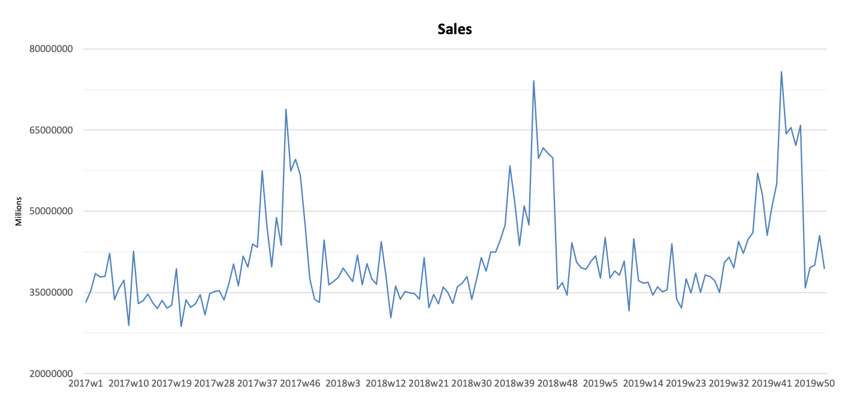
Predictive Analysis

Slide 43
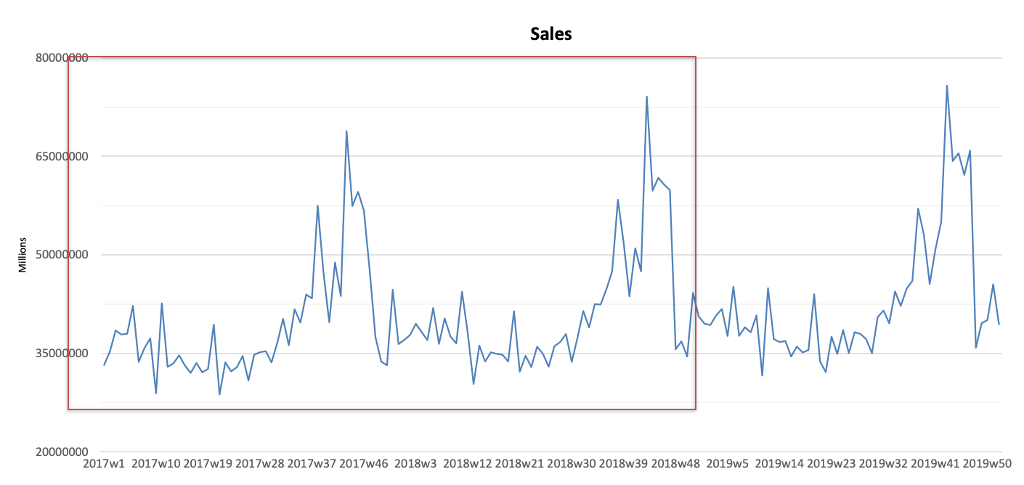
Predictive Analysis

Slide 44
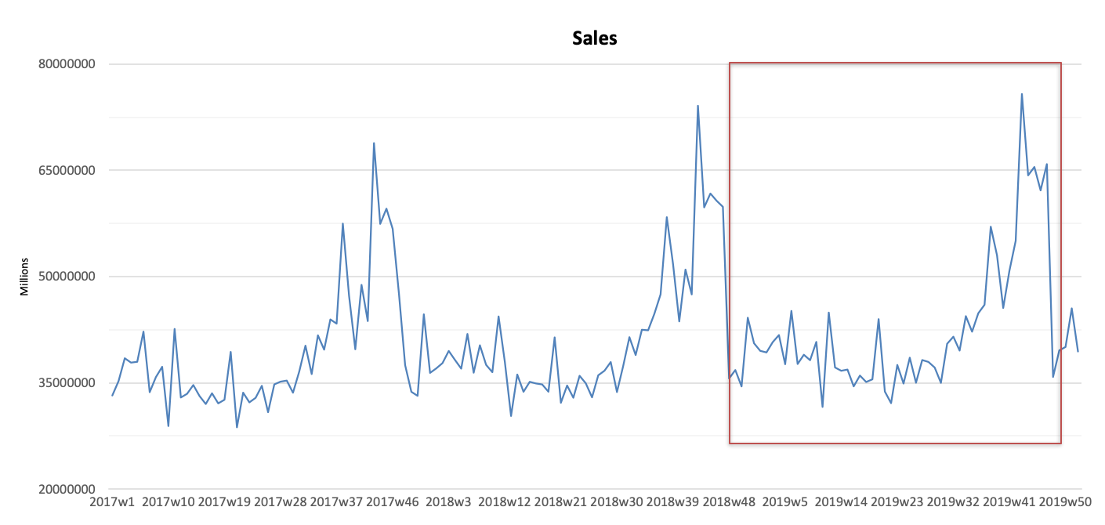
Predictive Analysis

Slide 45
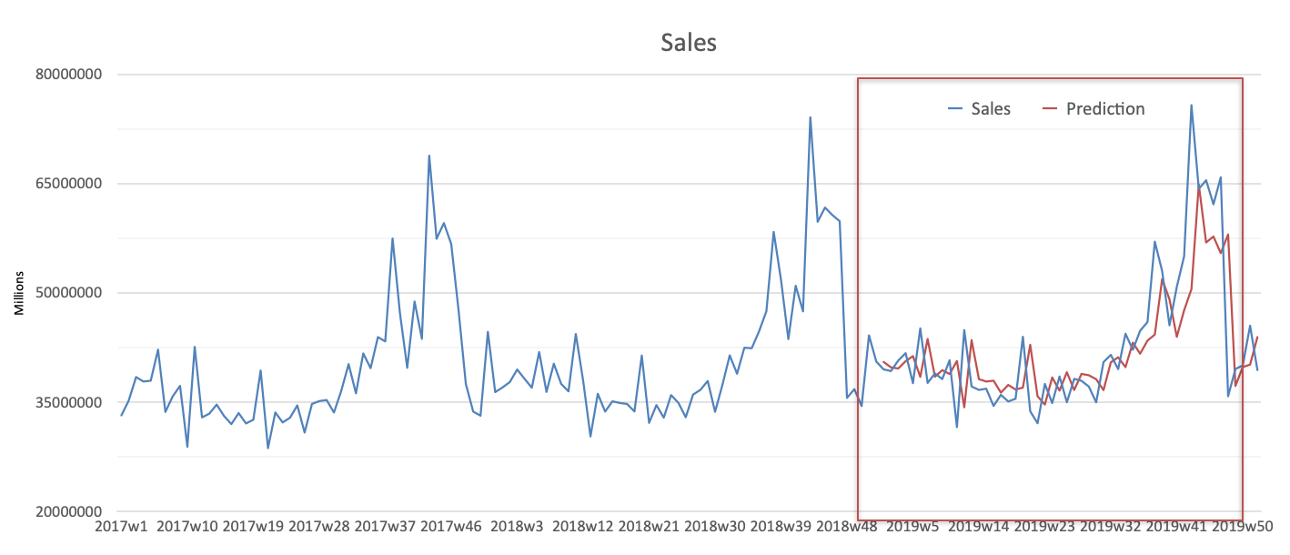
Predictive Analysis

Slide 46
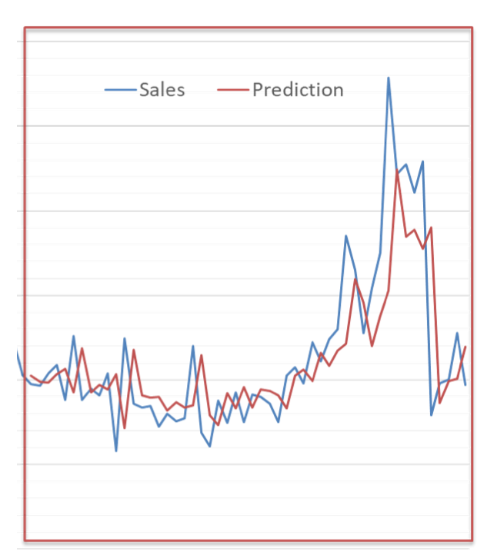
Predictive Analysis

Slide 47
Predictive Opportunities
Likelihood of shipment arriving on time
Likelihood of payment arriving on time
Likelihood of parts failing in our processes and/or our customer’s processes

Slide 48
Retail Digital Supply Chain
Prescriptive Analytics
Santiago Gallino, Charles W. Evans Distinguished Faculty Scholar and Assistant Professor of Operations, Information and Decisions

Slide 49
Prescriptive Analytics
How do I make it happen?
Will help a company make decisions in an automatic fashion

Slide 50
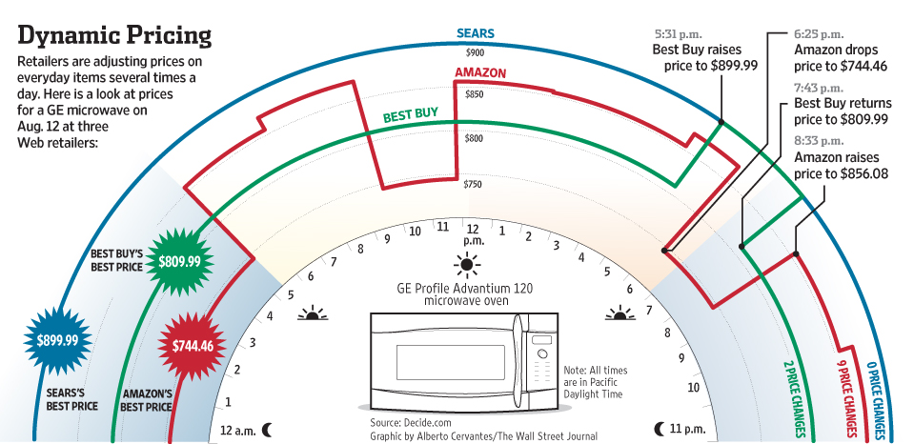
Prescriptive Analytics

Slide 51
Prescriptive Example
Retailer questions
Whether to respond or not?
To which particular competitor?
By how much?

Slide 52
Prescriptive Analytics
Applications of prescriptive analytics goes beyond pricing
Routing decisions
Where to allocate different products in the supply chain
Discounts and promotions decisions

Slide 53
Retail Digital Supply Chain
What to Do Next?
Santiago Gallino, Charles W. Evans Distinguished Faculty Scholar and Assistant Professor of Operations, Information and Decisions

Slide 54
Analytics Framework
Descriptive analytics
Diagnostic analytics
Predictive analytics
Prescriptive analytics
Business Impact
Complexity

Slide 55
What to Do Next?
What are some of the best practices when you start building your analytics capabilities?
Combine internal and external data sources
Enriches the data environment
Data validation
Break the silos
Make sure that anyone in the organization can communicate and share the information

Slide 56
What to Do Next?
What are some of the best practices when you start building your analytics capabilities?
Data analytics is embedded into the management process
Develop a data-driven decision-making process internally that will smooth the interaction between collecting the data, analyzing the data, and making decisions
Understand that “data-driven” does not mean data exclusive
Combines both the experience and the data analytics to make the best decisions going forward in the most effective way

Slide 57
Preventers
Data quality and information confidentiality issues
Poor data quality is going to guarantee the failure of any analytics effort
Internal resistance
Results are the best way to convince people internally that analytics is the way to go forward
Internal lack of sufficient analytic skills that will allow effective application of analytics across the organization
Everyone does not need to be an expert in analytics, but everyone need to be on board and willing to learn and improve their analytic skills

Slide 58
For Long Term Success
Leaders conversant in data science
Data analytics can not happen in a silo
Joint prioritization
Willingness to accept inconvenient outcomes

Slide 59
What Analytics is Right for You?
The only way to know if you have the right data, the right people, and the right skills is to just start simple
Build your confidence and leave the complexity for later
Incrementally is key
The goal of supply chain analytics is to help an organization make smarter, quicker, and more efficient decisions
Ultimately to create value

Slide 60
Where to Start?
5 questions to guide you in the process of identifying and succeeding in implementing an analytics project
What is the specific questions you would like to answer
What data do you have to answer that question?
What data do you need to answer that question?
What is your best guess on the answer you will find? Why?
What will happen if you are correct and what will happen if you are wrong?

Slide 61


